Slide 1
Load.in
Give your move a game plan.
Team Yellow
Feasibility Presentation
Old Dominion University
9/26/2020
Notes:
This slide is a non-animated version of the following slide. (Title Slide)

Slide 2
Load.in
Give your move a game plan.
Team Yellow
Feasibility Presentation
Old Dominion University
9/23/2020
Notes:
This slide is an animated version of the previous slide. (Title slide)

Slide 3
Contents
Team Biography: 4
The Problem: 8-16
Problem Statement: 9
Problem Characteristics: 11-16
Current Process Flow: 17-19
Major Functional Component Diagram: 20-21
Competition: 22-23
References: 24
Glossary: 25

Slide 4







Who is Team Yellow?
Byron Aquilino
Lance Perdue
Greg Kukanich
Jason Moran
Daniel Reyna
Chris Miller
Paul Rodriguez

Slide 5
“Do It Yourself” movers lack the expert knowledge required to handle the logistics of their move.

Slide 6
Professional Movers Are Costly
Notes:
https://www.hireahelper.com/movers-academy/on-the-job/estimating-job-times/
https://www.uhaul.com/Reservations/RatesTrucks/
https://www.move.org/average-cost-truck-rental/
https://www.victoryvan.com/moving-and-storage/how-long-takes-move-new-house

Slide 7
Americans Prefer to Move Themselves

Slide 8
Truck rental companies offer a variety of helpful moving supplies, but when it comes to the actual move, will only refer you to unaffordable professional movers. As a result, “Do It Yourself” movers are often left to fend for themselves in managing moving logistics and uncertainties with little prior experience. Load.In aims to give your move a game plan by quantifying uncertainties and assisting in logistical endeavors on moving day.

Slide 9
Professional Movers Are Costly
Based on 4 Movers at Average rate of $50/HR to $100/HR
https://www.mymovingreviews.com/move/average-moving-cost/

Slide 10
78.3% of Americans go without the help of professional movers.
MoveBuddha.com

Slide 11
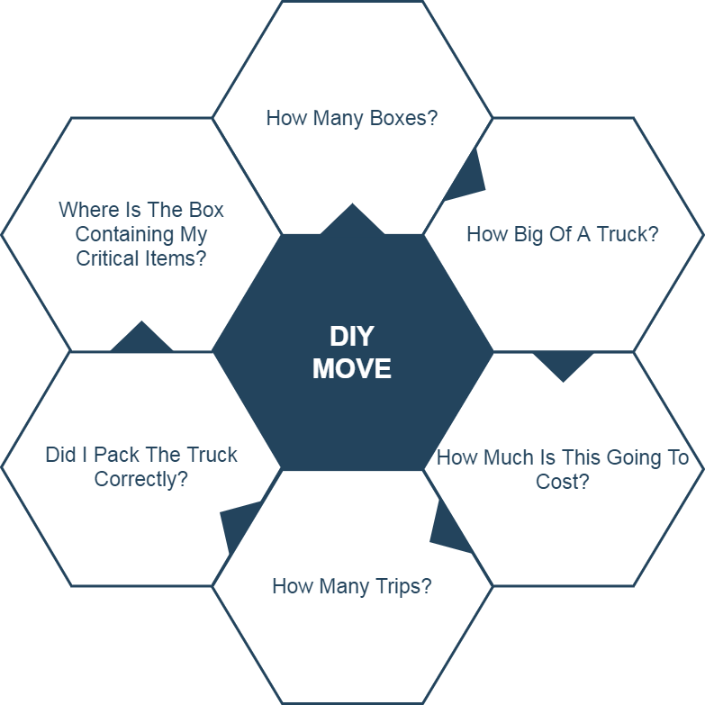
Moving is Challenging
These logistics make moving, which is already a stressful life event, even more stressful.

Slide 12
Accurately determining how big of a truck to get and how many trips a move will take is difficult. Rental Truck companies base their business model on this!
wtkr.com

Slide 13
Loading a truck properly requires many considerations including weight distribution and protecting fragile items.
PenskeTruckRental.com

Slide 14
Poor packing can result in property damage and in the worst case, a car accident. An estimated 50,000 accidents related to trailer towing occur each year.
Hayesbc.com

Slide 15
35% of Americans are stressed the most by logistics and packing.
Article.com

Slide 16
What is the current process?

Slide 17
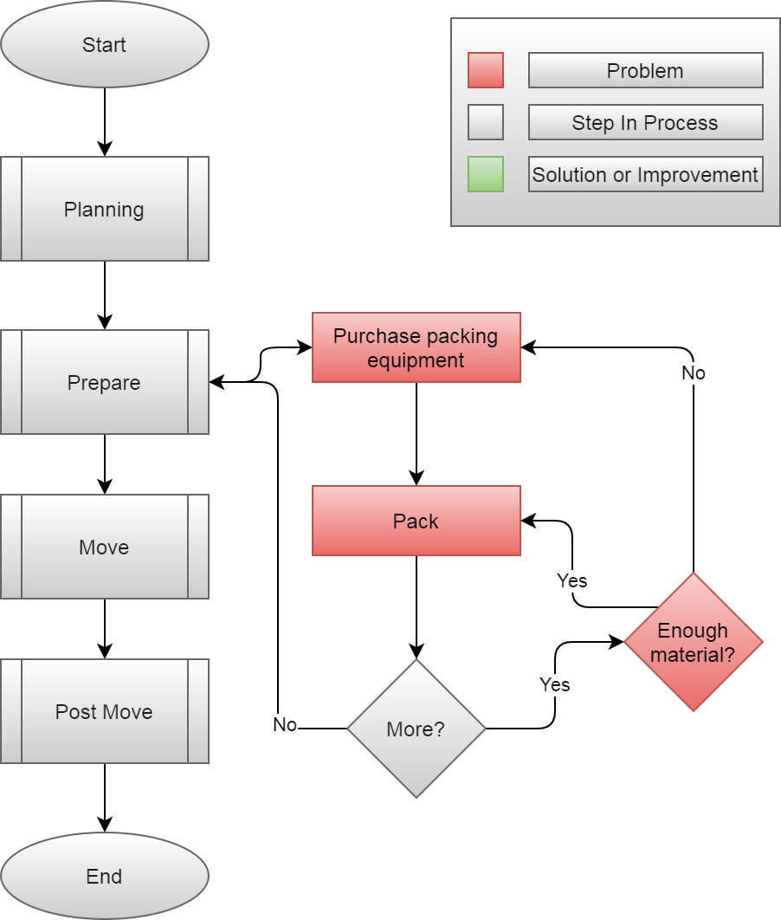

Slide 18
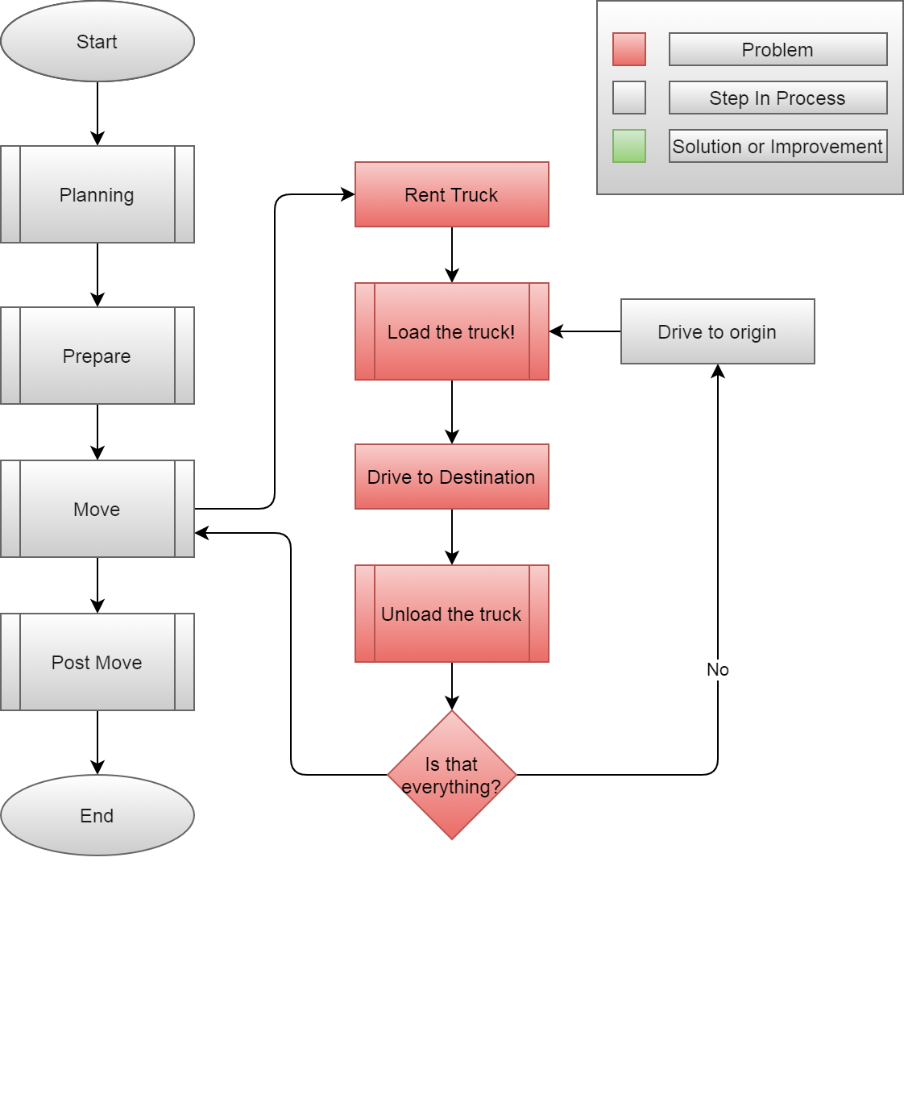

Slide 19
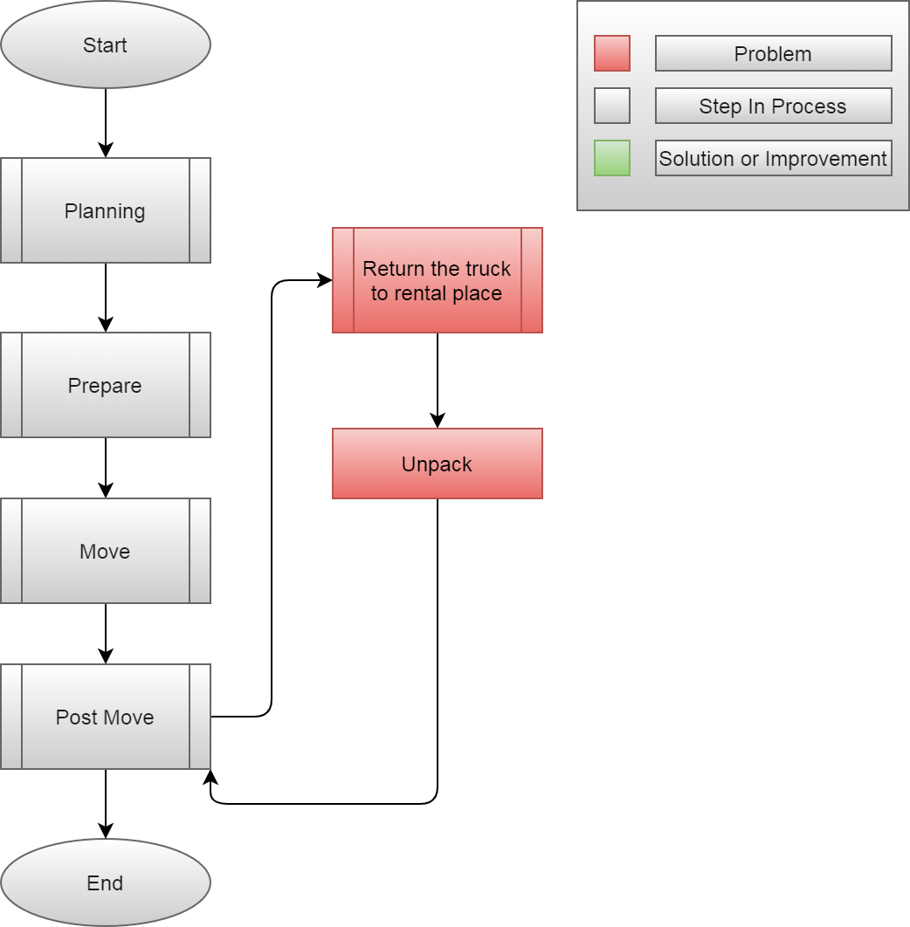

Slide 20
Solution Definition

Slide 21
Load.In aims to give your move a game plan by quantifying uncertainties and assisting in logistical endeavors on moving day.

Slide 22
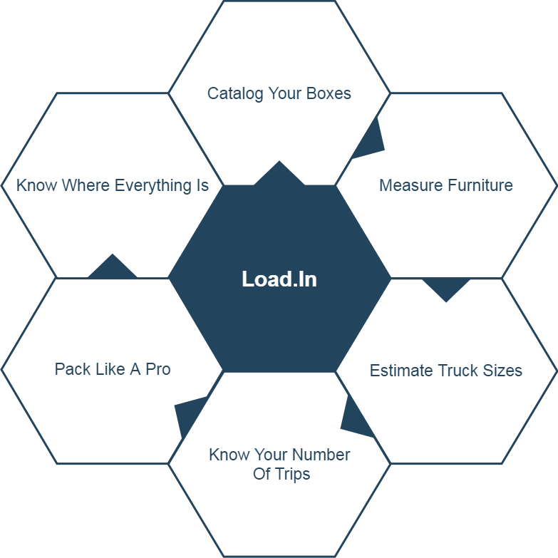
Solution Characteristics

Slide 23
How will the solution help the process?

Slide 24
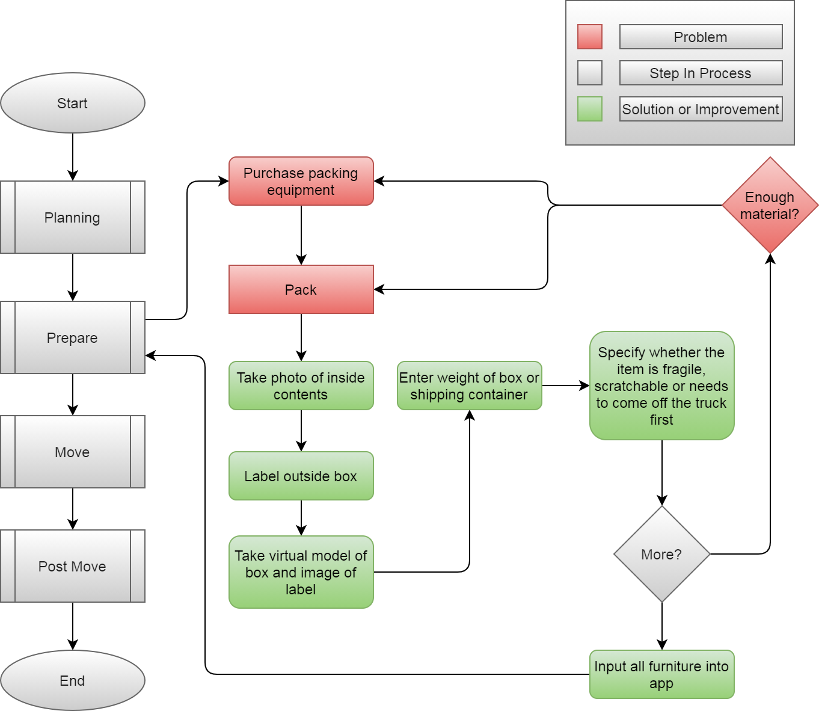

Slide 25
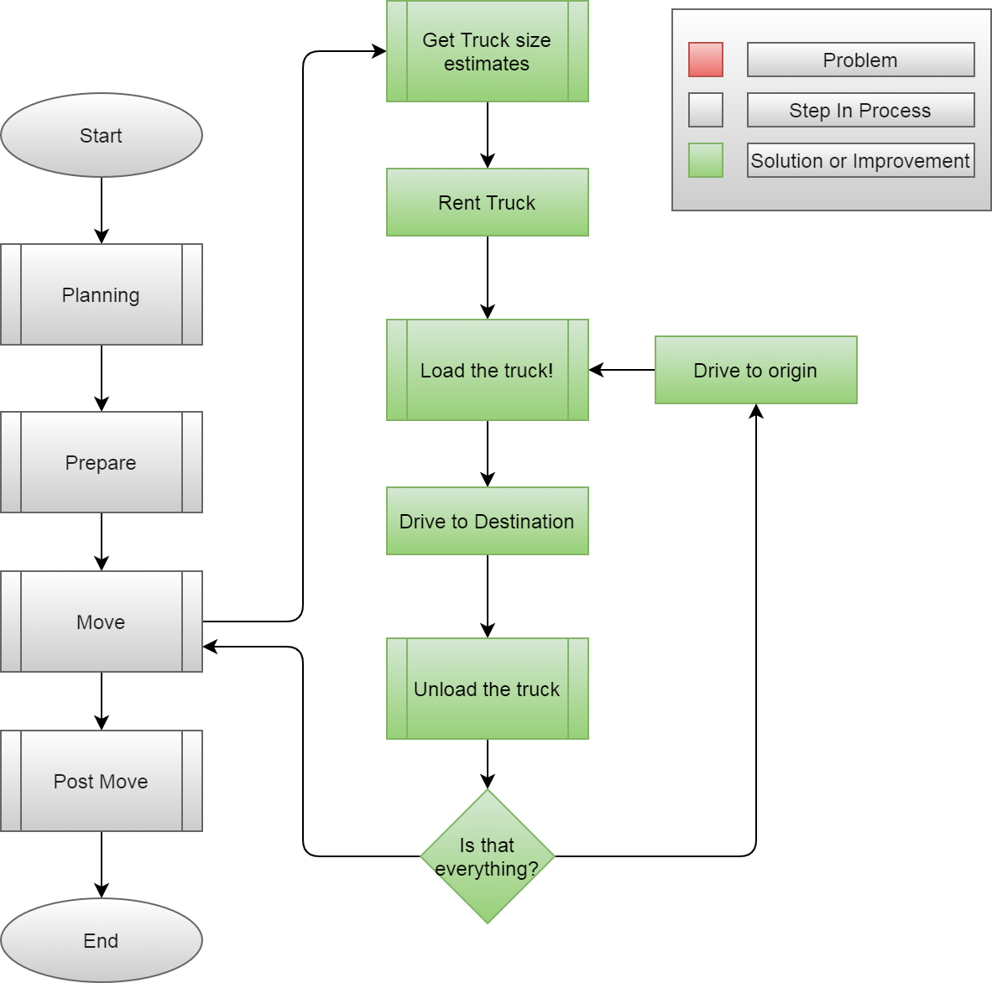

Slide 26
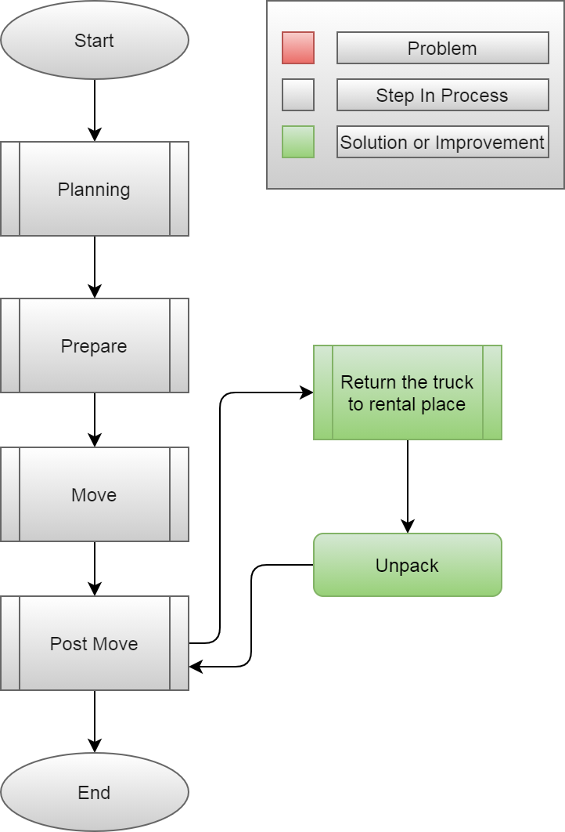

Slide 27
What are the major functional components?

Slide 28
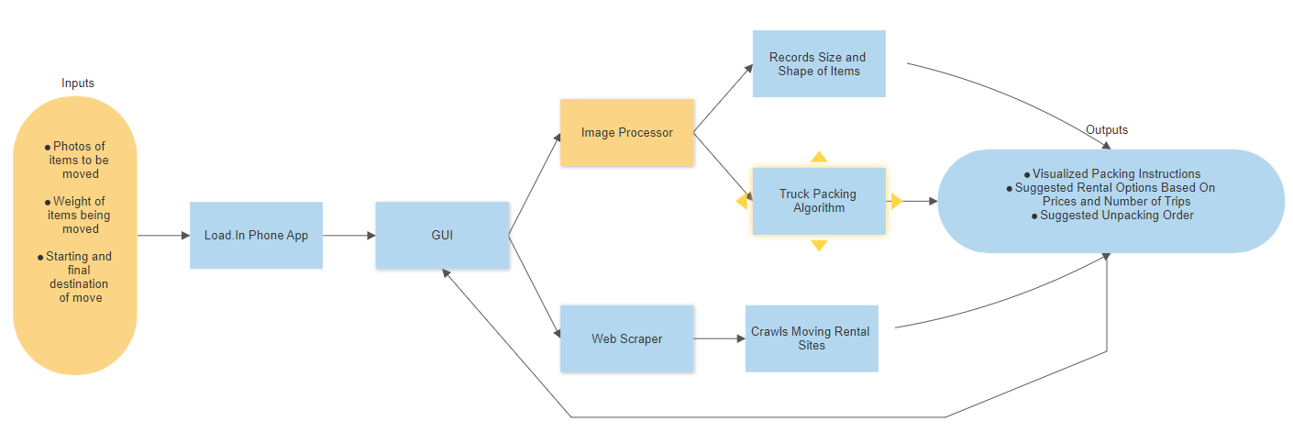

Slide 29
Feasibility Analysis

Slide 30
Per the rubric, add “Description of what proposed solution will do” here

Slide 31
Per the rubric, add “Description of what proposed solution will NOT do” here

Slide 32
Per the rubric, add “Market analysis & benefits to the customer base” here

Slide 33
Risks & Mitigation

Slide 34
Per the rubric, add “Customer Risks” here

Slide 35
Per the rubric, add “Technical Risks” here

Slide 36
What’s the competition like?

Slide 37
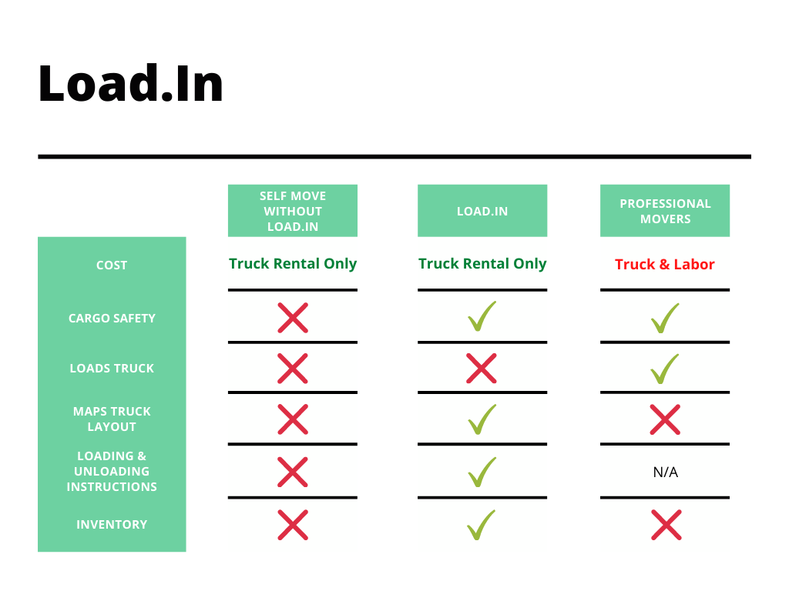

Slide 38
Notes:
End of presentation.

Slide 39
Sources:
The Top 5 Moving Mistakes Across America. (2019, August 13). Article. https://www.article.com/blog/top-5-moving-mistakes/
Economy Moving & Storage, LLC. (2015, January 4). How to properly pack and load a moving truck- Movers Cincinnati. YouTube. https://www.youtube.com/watch?v=rjmofUZOdwo&feature=youtu.be
CADCode Systems. (n.d.). Optimizing & Machining | CADCode Systems. CADCode.Com. Retrieved September 20, 2020, from https://www.cadcode.com/category/categories/optimizing-machining
Dube, E. (2020, September 20). OPTIMIZING THREE-DIMENSIONAL BIN PACKING THROUGH SIMULATION. Semantics Scholar. https://www.semanticscholar.org/paper/OPTIMIZING-THREE-DIMENSIONAL-BIN-PACKING-THROUGH-Dube/bb9986af2f26f7726fcef1bc684eac8239c9b853#references
Knoblauch, M. (2019, May 8). One in ten Americans would prefer a week in jail over moving. New York Post. https://nypost.com/2019/05/08/one-in-ten-americans-would-prefer-a-week-in-jail-over-moving/
The American Institute of Stress. (n.d.). The Holmes-Rahe Stress Inventory PDF. Retrieved September 20, 2020, from https://www.stress.org/wp-content/uploads/2019/04/stress-inventory-1.pdf
Wood, T. (2020, January 6). Moving Industry Statistics. MoveBuddha. https://www.movebuddha.com/blog/moving-industry-statistics/
Nat and Friends. (2017, April 18). Google Earth’s Incredible 3D Imagery, Explained. YouTube. https://www.youtube.com/watch?v=suo_aUTUpps&feature=youtu.be
Collins, T. (2018, April 20). A Look Into Photogrammetry and Video Games - Tiger Collins. Medium. https://medium.com/@homicidalnacho/a-look-into-photogrammetry-and-video-games-71d602f51c31

Slide 40
Glossary:
*All definitions are sourced from Wikipedia
Photogrammetry
Photogrammetry is the science and technology of obtaining reliable information about physical objects and the environment through the process of recording, measuring and interpreting photographic images and patterns of electromagnetic radiant imagery and other phenomena.
Algorithm
A finite sequence of well-defined, computer-implementable instructions, typically to solve a class of problems or to perform a computation.
Professional movers
Professionals who move all your belongings for you from one place to another.
Packing problems
Are a class of optimization problems in mathematics that involve attempting to pack objects together into containers. The goal is to either pack a single container as densely as possible or pack all objects using as few containers as possible.

